Slide 1

Überblick Microsoft Cloud Adoption Framework
Ready

Slide 2
Plan
An iterative process that supports your business … as it evolves
Govern
Manage
Define strategy
Adopt
Ready

Slide 3
Cloud Adoption Framework: Ready
The ‘Ready’ module establishes a cloud foundation or adoption target that can provide hosting for any adoption efforts.
1
Azure setup guide
Azure setup guidance on the tools and approaches you need to create a landing zone.
2
First landing zone
Choose the most appropriate landing zone option to establish a code-based starting point for your environment.
3
Expand the blueprint
Meet the platform considerations of your cloud adoption plan by expanding your landing zone.
4
Best practices
Validate landing zone modifications against best practices.

Slide 4
Ready
Define strategy
Plan
Ready
Adopt
Ready establishes a cloud foundation or Adoption Target that can provide hosting for any adoption efforts. This should consist of common denominators across 80–90% of cloud adoption.
Govern
Manage
Azure readiness guide
Resource management: management groups, subscriptions, resource groups, resources tree hierarchy
Naming Standards
Resource tags
Landing zone infrastructure
Network design: Vnet, hybrid, firewall, hub, front door, endpoints
Storage design: disk, file, blobs, CDN
Compute design: VMs, containers, apps, serverless
Data design: Structured/ unstructured
Landing zone ID
Identity and access
Role-based access control RBAC
Manage to least privilege
Landing zone cost
Costs and billing
Analyze Cloud Costs
Monitor with budgets
Optimize with recommendations
Manage invoices and payments
Blueprints
AI
BigData
Hybrid networks
Identity management
IoT
Serverless
SAP
VMs
WebApps
DevOps

Slide 5
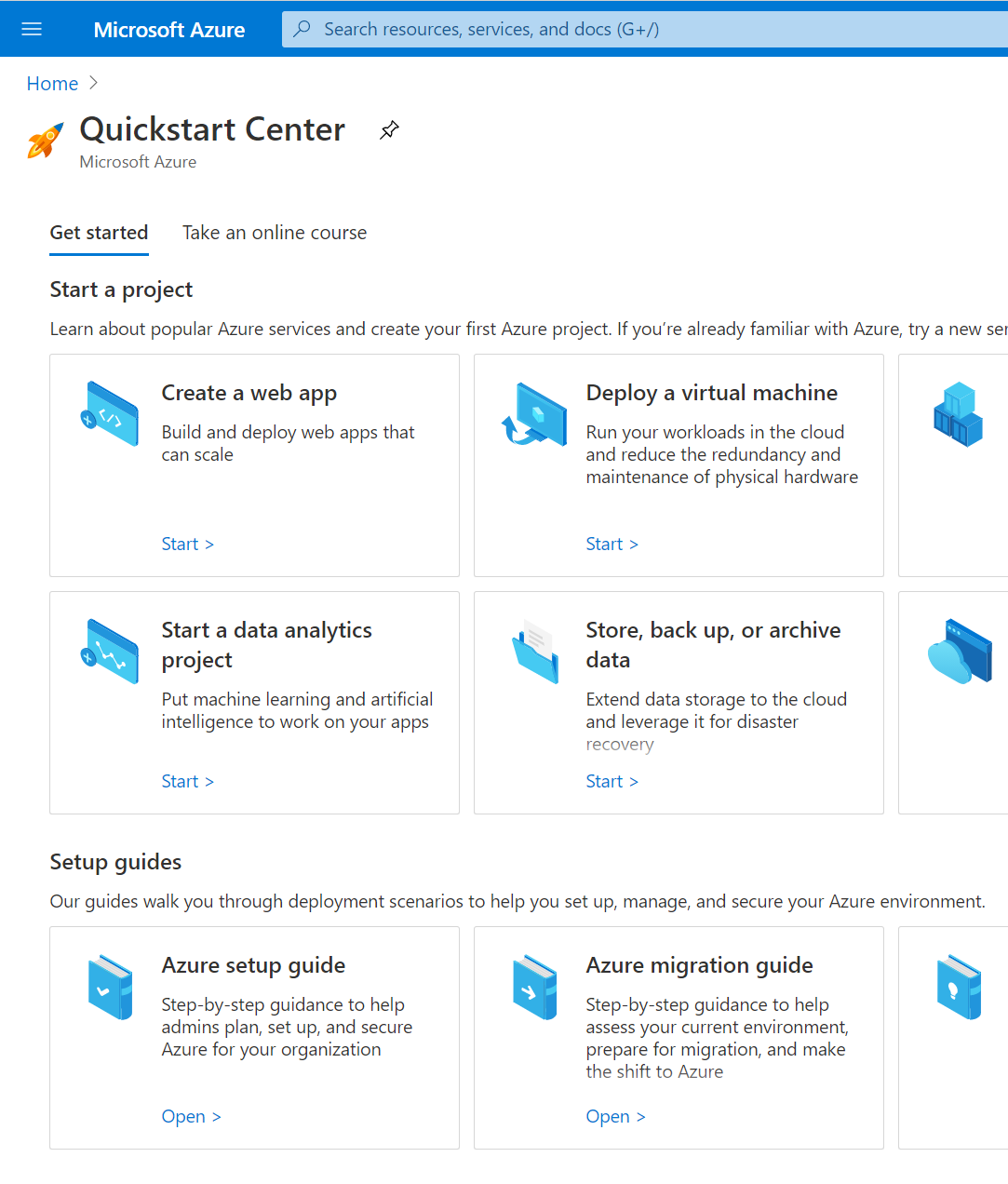

Ready | Azure setup guide
Prepare the cloud environment before building and deploying solutions using Azure services
The Azure setup guide provides guidance on how to organize resources, control costs, and secure and manage your organization helping you create your landing zone in Azure
The guide is also published in the Azure Quickstart Center within the Azure Portal

Slide 6
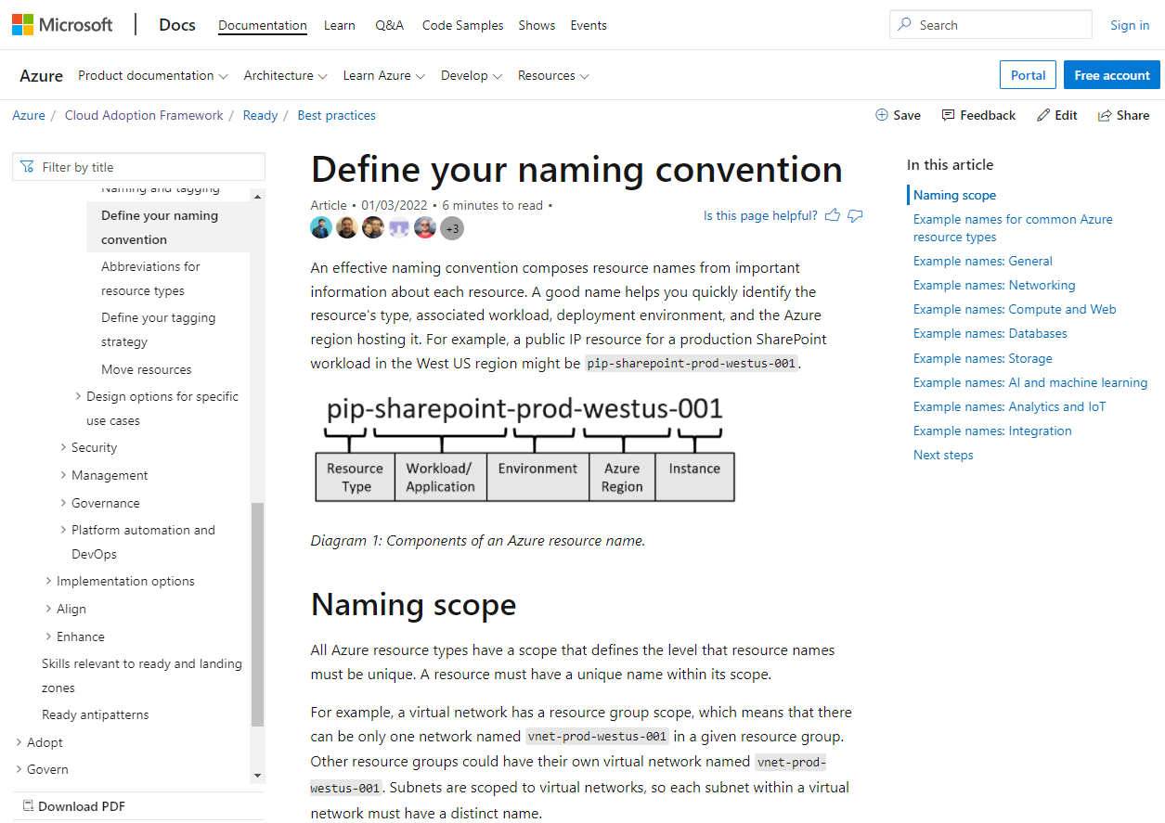
Ready | Azure Naming Convention

Slide 7
Ready
Define strategy
Plan
Ready
Adopt
Ready establishes a cloud foundation or Adoption Target that can provide hosting for any adoption efforts. This should consist of common denominators across 80–90% of cloud adoption.
Govern
Manage
Azure readiness guide
Resource management: management groups, subscriptions, resource groups, resources tree hierarchy
Naming Standards
Resource tags
Landing zone infrastructure
Network design: Vnet, hybrid, firewall, hub, front door, endpoints
Storage design: disk, file, blobs, CDN
Compute design: VMs, containers, apps, serverless
Data design: Structured/ unstructured
Landing zone ID
Identity and access
Role-based access control RBAC
Manage to least privilege
Landing zone cost
Costs and billing
Analyze Cloud Costs
Monitor with budgets
Optimize with recommendations
Manage invoices and payments
Blueprints
AI
BigData
Hybrid networks
Identity management
IoT
Serverless
SAP
VMs
WebApps
DevOps

Slide 8

Metropolis
Using an analogy, this is similar to how city utilities such as water, gas, and electricity are accessible before new houses are constructed. In this context, the network, IAM, policies, management, and monitoring are shared 'utility' services that must be readily available to help streamline the application migration process.
Copyright © Michele D’Ottavio

Slide 9
Landing zones
Landing Zone Design
Landing Zone (Subscription)
Azure landing zones are the output of a multi-subscription Azure environment that accounts for scale, security, governance, networking, and identity.
The landing zone ensures that applications or workloads landing on Azure have the required “plumbing” in place, providing greater agility and compliance with enterprise security and governance requirements.
Roles e.g. NetOps, SecOps, DevOps
IAM
Management & Monitoring
Metrics, Logs, and Alerts
Security Center
Subscription Policy e.g. allowed resource providers
Encryption at-rest
No Public IP
Policy
Application
Application
Cost Management
App Resources (VM, DB, Storage)
Application
IAM
Policy
Application Template
Application
Keys
Monitor
Azure Monitor
Shared Services e.g. Active Directory (IaaS)
Inbound and Outbound
Corp Connectivity
Intra and Inter Landing Zone
Shared Services
Networking
Network Watcher
Security Center

Slide 10
First landing zone
More
Policy
C
ISO 27001 – Shared Services
ISO 27001 – ASE/SQL Workload
NIST SP 800-53 Rev 4
UK Official
A landing zone is a pre-provisioned environment for hosting your workloads. It uses a defined set of cloud services and best practices to add foundational capabilities that set you up for success.
If you’re unsure where to begin, the Cloud Adoption Framework migrate landing zone blueprint creates a landing zone which can be updated to meet your specific needs.
Primitives
B
Network
D
Partner blueprints
Identity
A
Compliance requirements
Data
CAF Migrate Landing Zone Blueprint
Storage
Compute
Less
Less
Architectural complexity
More

Slide 11
Landing zone considerations
The major considerations for implementing any landing zone deployment can be broken up into three main categories: hosting, Azure fundamentals, and governance.
HOSTING
Compute
Network
Storage
Data
AZURE FUNDAMENTALS
Management groups
Resource groups
Naming standards
Subscription design
GOVERNANCE
Cost
Monitoring
Identity
Policy

Slide 12
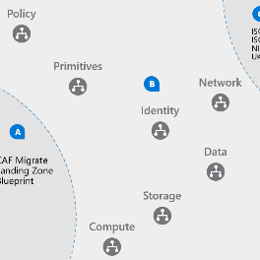
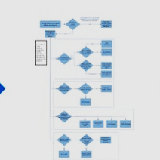
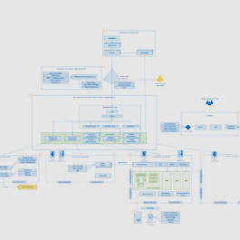
Refactoring landing zones
Since landing zone infrastructure is defined in code, it can be refactored like any other codebase. Refactoring is the process of modifying or restructuring source code to optimize the output of that code without changing its purpose or core function.
Initial landing zone
Decision trees/ refactoring
Future state/ Enterprise Ready

Slide 13
Landing zone development approach

Slide 14



Key Challenges
Architecture Complexity
Customers lack the required level of understanding and experience on Azure. The mismatch between on-premises infrastructure and cloud-design considerations creates dissonance and friction with respect to defining architectures and standards for their migration to the cloud. They are struggling with the translation of their requirements to Azure concepts, capabilities, constructs and security model.
Operating Compatibility
Existing approaches and functions for the traditional delivery and management of IT services are not compatible with the Azure platform and cloud operating models. When combined with a lack of skills and experience, customers are struggling to define and therefore transform their operating model to manage and support large-scale cloud infrastructure.
Lack of Trust and Desire for Control
The absence of a precise and detailed cloud architecture that is compliant with their requirements, and the lack of a well-defined operating model to support such a platform, leads IT not to trust Azure and instead strive to maintain full control. This often involves building ‘walls’ and complicated processes which ultimately get in the way of business lines adopting Azure.

Slide 15
Common path – common blocker Acting too soon
100% alignment on the Azure environment
First workload
First 10 workloads
First production workloads
First 100 workloads

Slide 16
Common path – common blocker Acting too late
First workload
First 10 workloads
First production workloads
First 100 workloads
Enterprise readiness

Slide 17
Development approach
First workload
First 10 workloads
First production workloads
First 100+ workloads
Cloud adoption: migrate or innovate
Landing zone
Connected environments
Secure landing zones
Shared services model
CCoE and operating model
Cloud platform: Refactoring landing zones

Slide 18
Refactor to enterprise readiness during this process
Cloud operations
First workload
First 10 workloads
First production workloads
First 100+ workloads
Cloud adoption: migrate or innovate
Landing zone
Connected environments
Secure landing zones
Shared services model
CCoE and operating model
Cloud platform: Refactoring landing zones
Landing zone considerations
Cloud governance
Cloud security

Slide 19
Ready
Define strategy
Plan
Ready
Adopt
Ready establishes a cloud foundation or Adoption Target that can provide hosting for any adoption efforts. This should consist of common denominators across 80–90% of cloud adoption.
Govern
Manage
Azure readiness guide
Resource management: management groups, subscriptions, resource groups, resources tree hierarchy
Naming Standards
Resource tags
Landing zone infrastructure
Network design: Vnet, hybrid, firewall, hub, front door, endpoints
Storage design: disk, file, blobs, CDN
Compute design: VMs, containers, apps, serverless
Data design: Structured/ unstructured
Landing zone ID
Identity and access
Role-based access control RBAC
Manage to least privilege
Landing zone cost
Costs and billing
Analyze Cloud Costs
Monitor with budgets
Optimize with recommendations
Manage invoices and payments
Blueprints
AI
BigData
Hybrid networks
Identity management
IoT
Serverless
SAP
VMs
WebApps
DevOps

Slide 20
Best practices

Slide 21
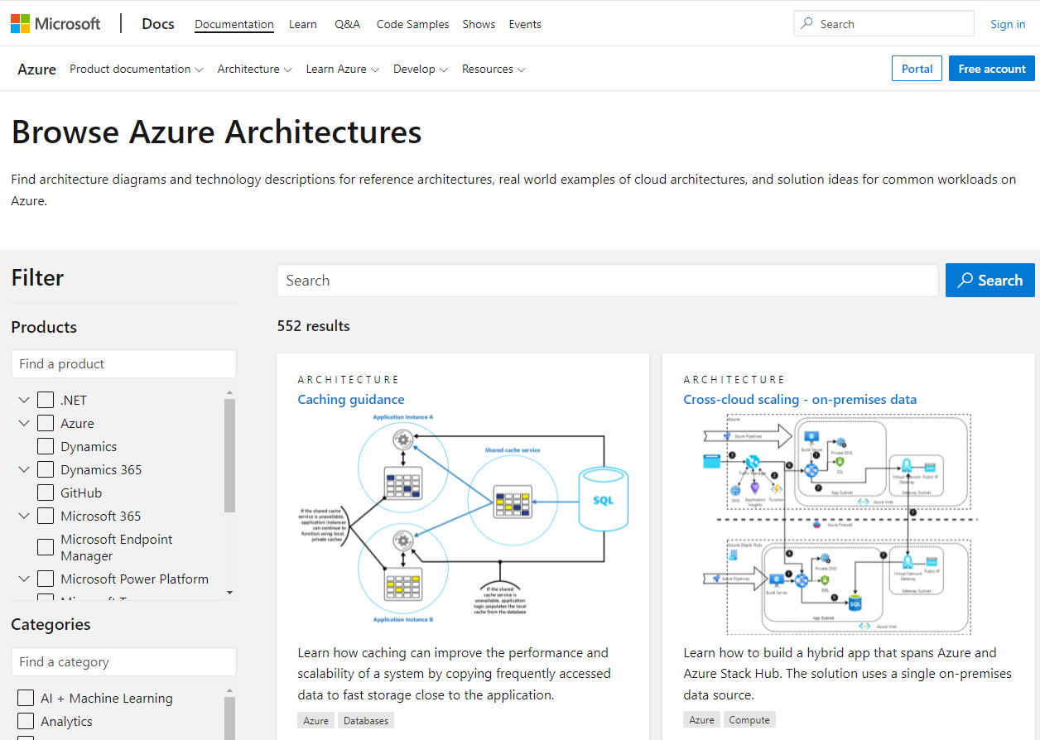
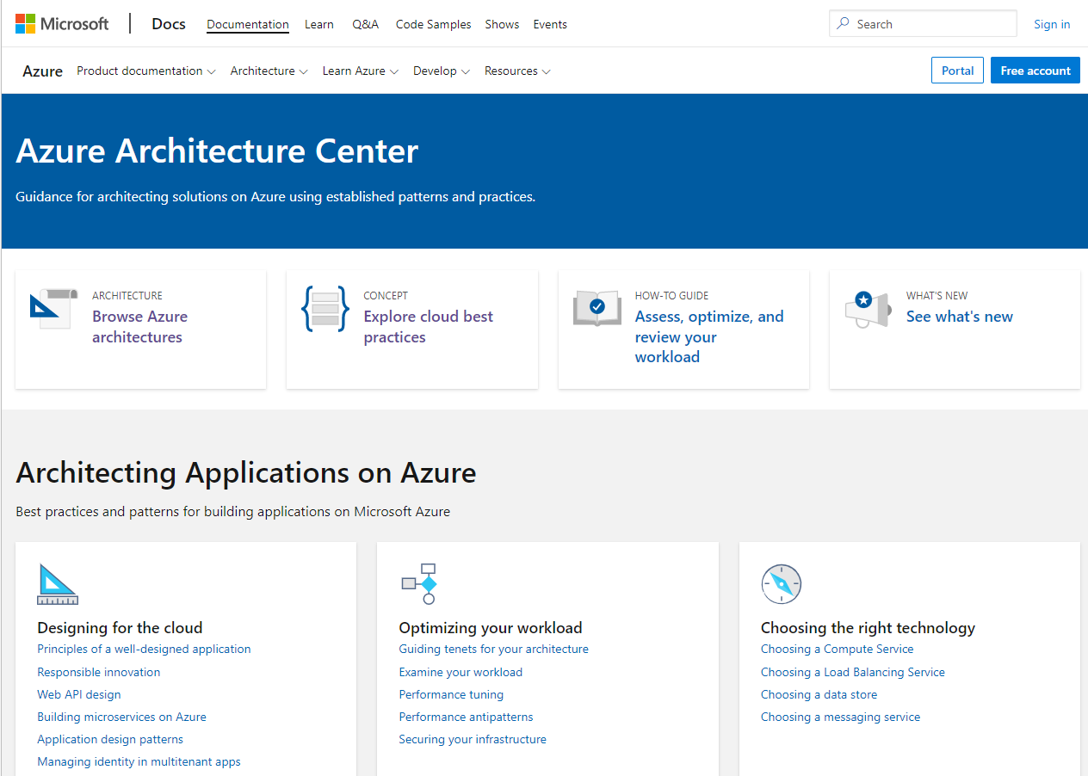
Azure Architecture Center

Slide 22






Equip your staff with the technical skills needed to begin a cloud adoption effort and prepare your environment for the assets and workloads you’ll move to the cloud.
Azure subscriptions
Networking
Identity management
Storage security
Database security
Cost management
https://aka.ms/adopt/ready-bestpractices

